Slide 1
E-Auction System Mohammed Tariq

Slide 2
Problem
1.Fraud

Slide 3

solution

Slide 4

Endpoints
getProductbyStatus()
lastDateToAddOffer()
addNewOffer()
getSimilarFavoriteProductForUser()
getOwnerRatesForUser()
GetBestOwnerRates()

Slide 5
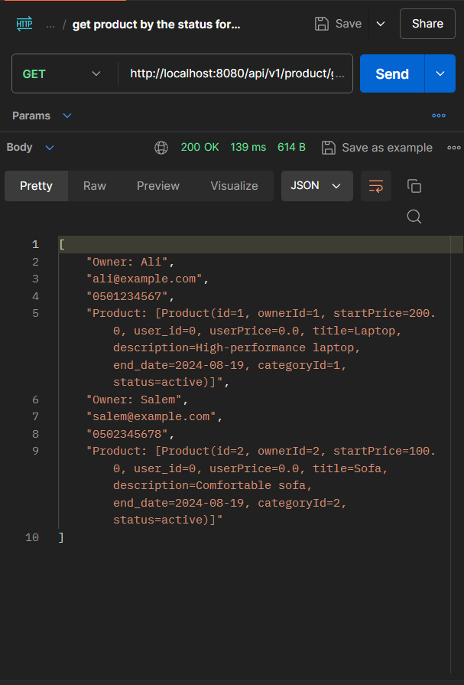
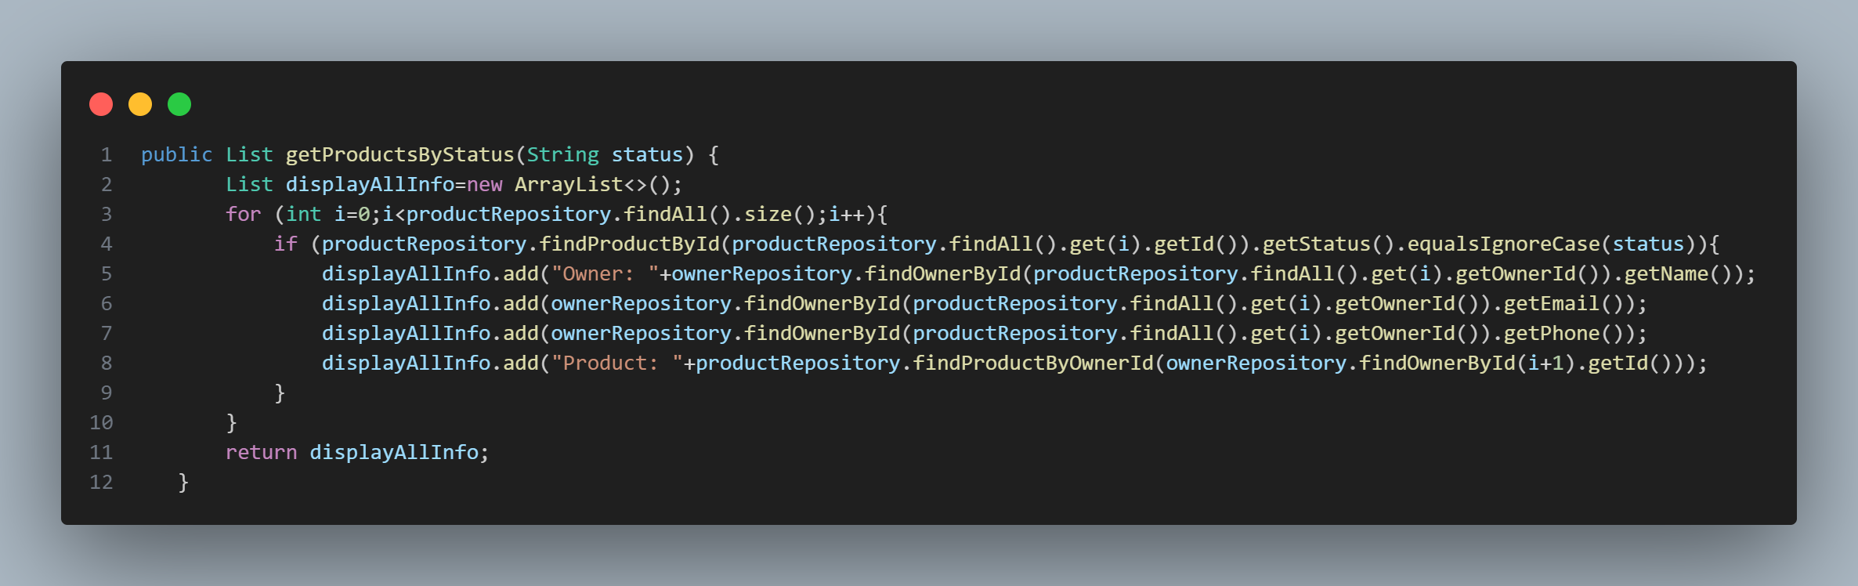
getProductbyStatus()

Slide 6
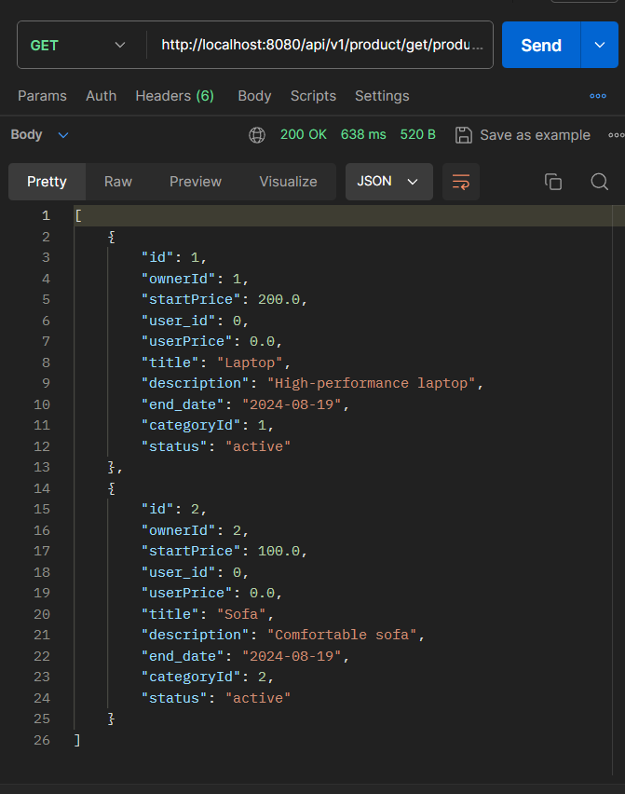
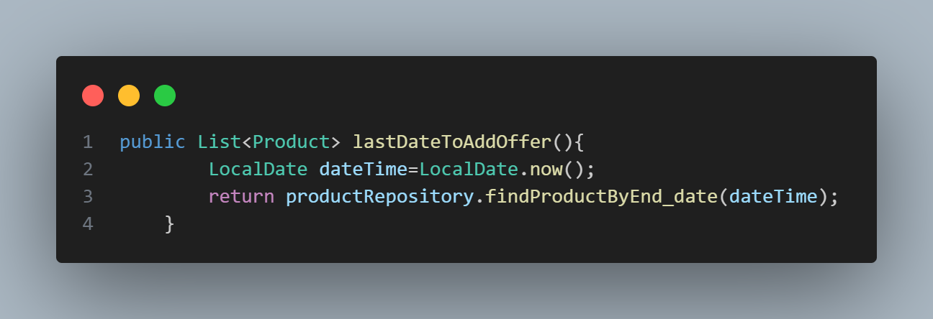
2.lastDateToAddOffer() ()

Slide 7
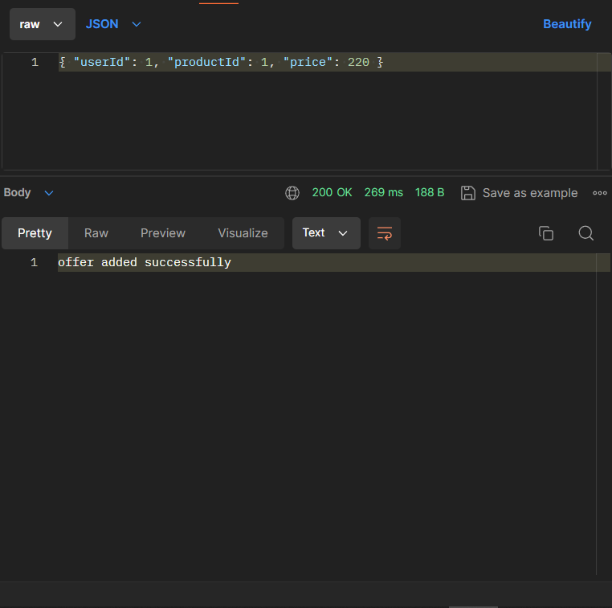
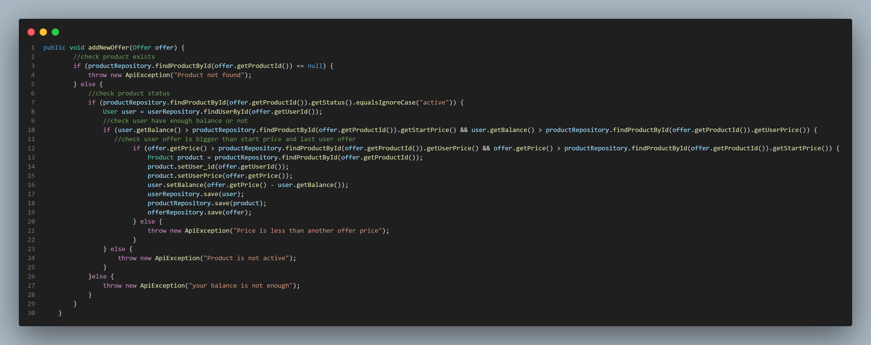
3.addnewoffer() ()

Slide 8
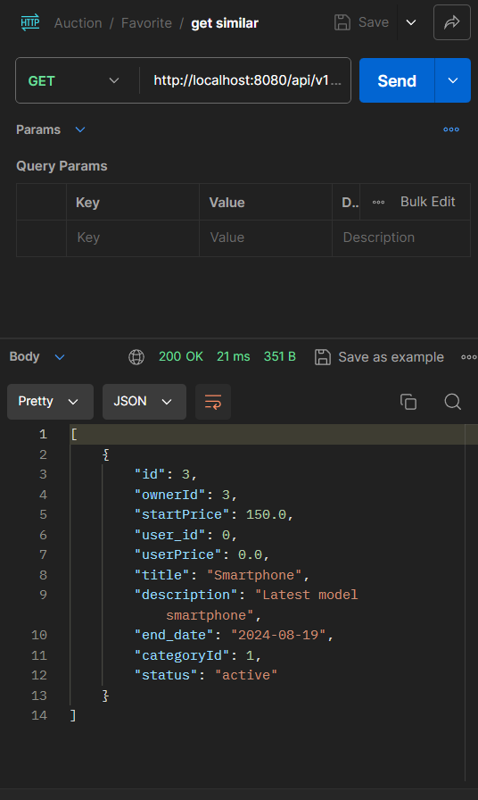
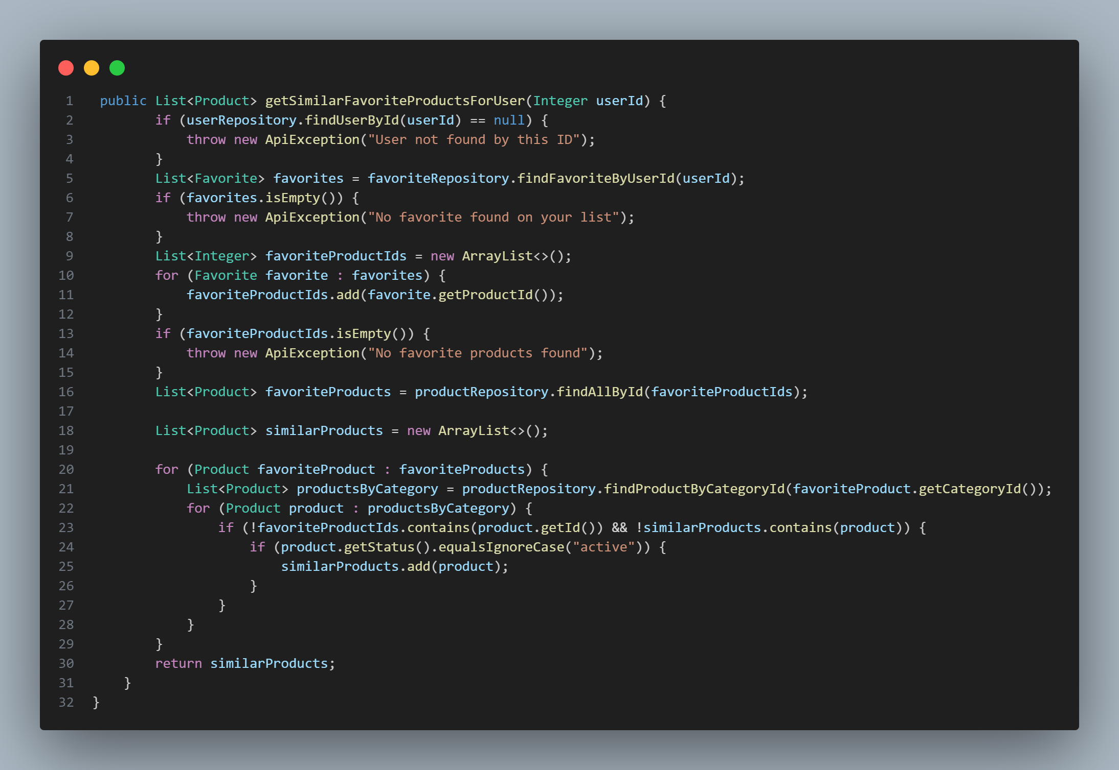
4.getsimilarfavoriteforuser()

Slide 9
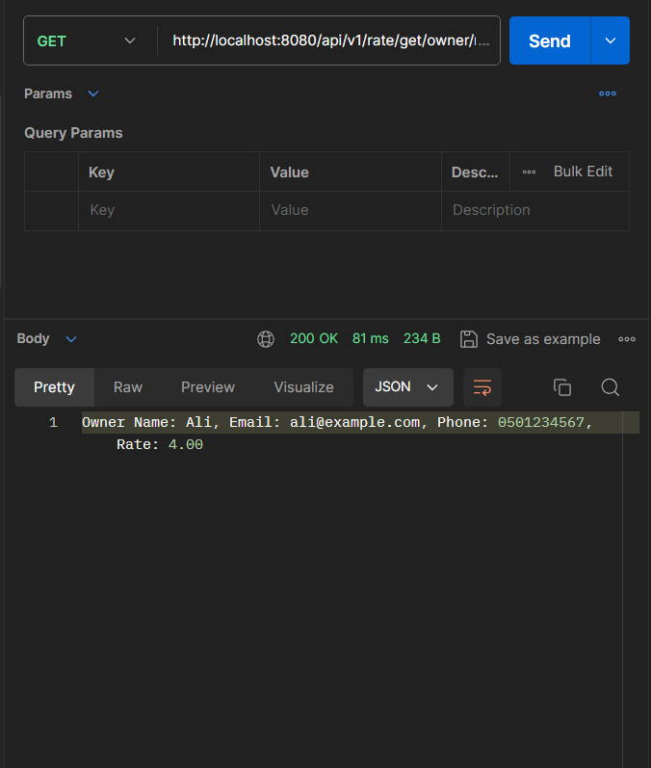
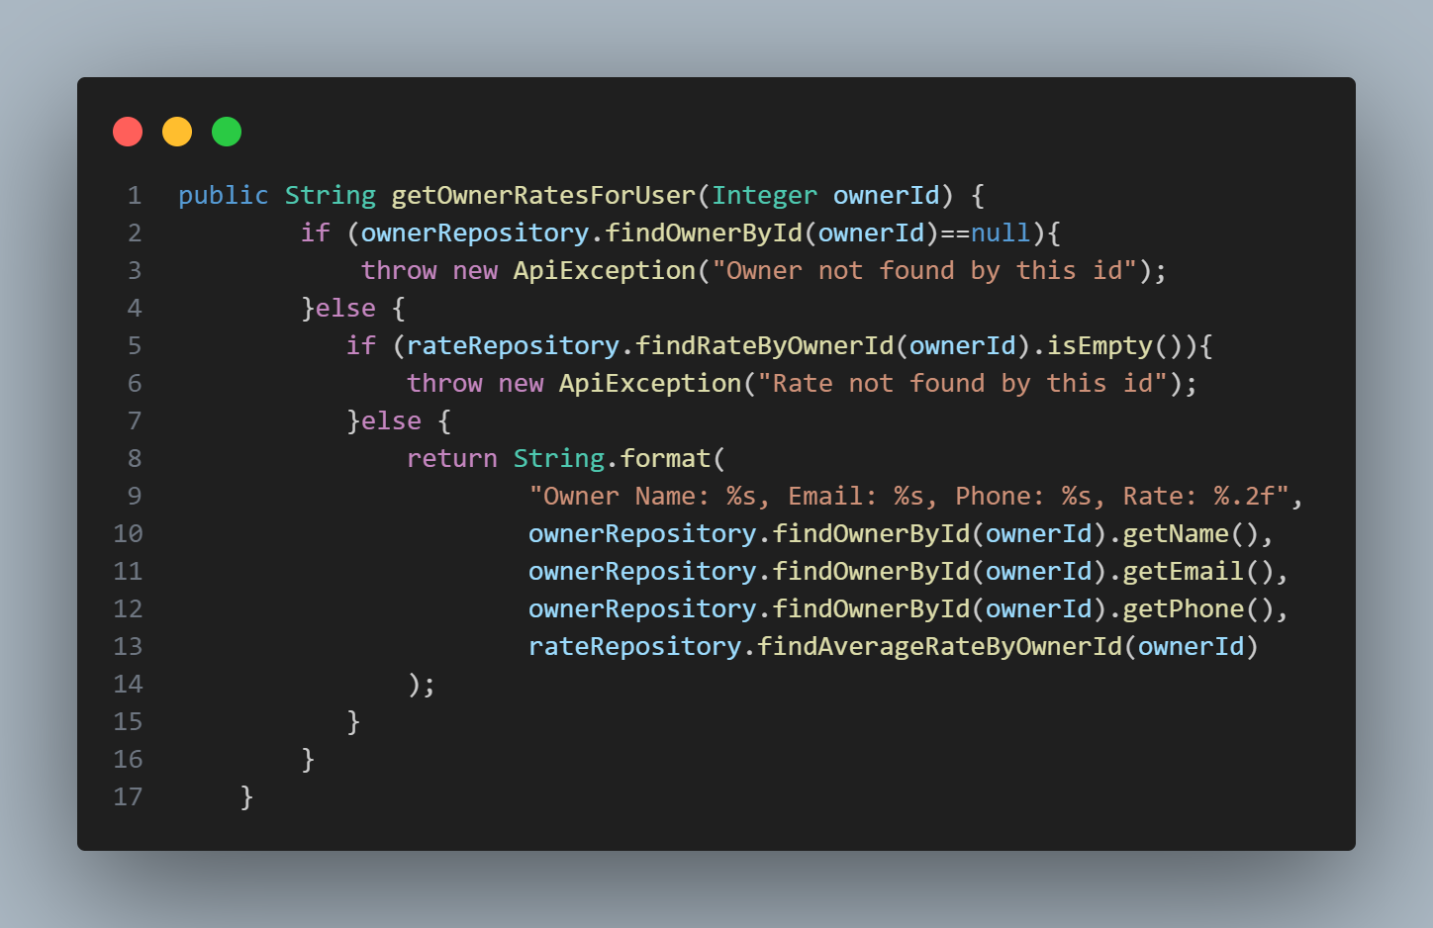
5.getownerrateforuser()

Slide 10
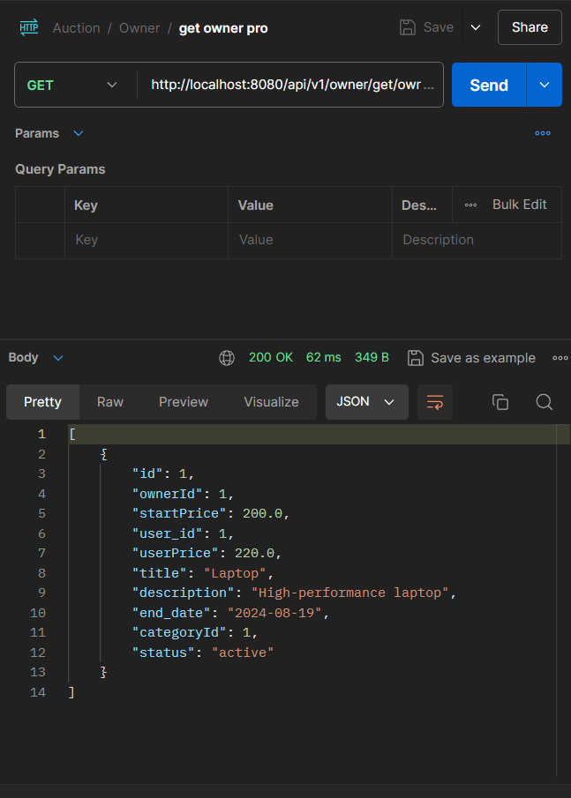
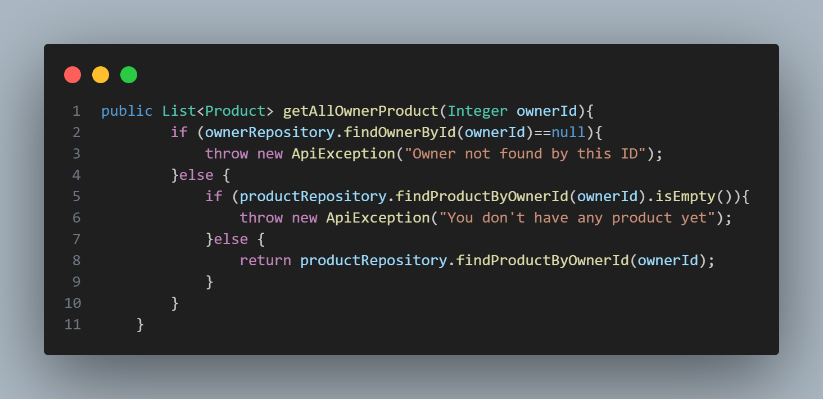
6.getallownerproduct()

Slide 11
THANK YOU

